Slide 1
Welcome!
Please, have a seat.
CWRU Quants
quants@case.edu
Notes:
Sources: https://github.com/CppCon/CppCon2017/blob/master/Presentations/When%20a%20Microsecond%20Is%20an%20Eternity/When%20a%20Microsecond%20Is%20an%20Eternity%20-%20Carl%20Cook%20-%20CppCon%202017.pdf https://blog.cloudflare.com/branch-predictor/

Slide 2
Agenda
Part 1 Recap
Institutional Quants
Notes:
Christo

Slide 3

Attendance | CampusGroups
Notes:
Christo

Slide 4

Discord (important!)
Notes:
Christo

Slide 5
What happened last time?
HFT fundamentals
Software Optimizations
branching
caching
inlining
Hardware
cache locality
minimize noisy neighbors
Question: So as a computer science student, or anyone working with software requiring high performance, what does this show you?
Notes:
Christo

Slide 6
Question: So as a computer science student, or anyone working with software requiring high performance, what does this show you?
Notes:
Christo

Slide 7
Question: So as a computer science student, or anyone working with software requiring high performance, what does this show you?
Answer: There’s a reason why people do this in low level languages such as C++!
Abstractions are great for productivity, but they can hide performance bottlenecks.
You also need to know what the machine is doing, and how those instructions interact with the CPU cache, memory, and branches
How your compiler turns code into instructions
how instructions interact with CPU cache, memory, and branches
There’s no One Trick – It’s Holistic across the entire stack
compiler flags, memory allocation, cache behavior, etc.
Notes:
Christo

Slide 8
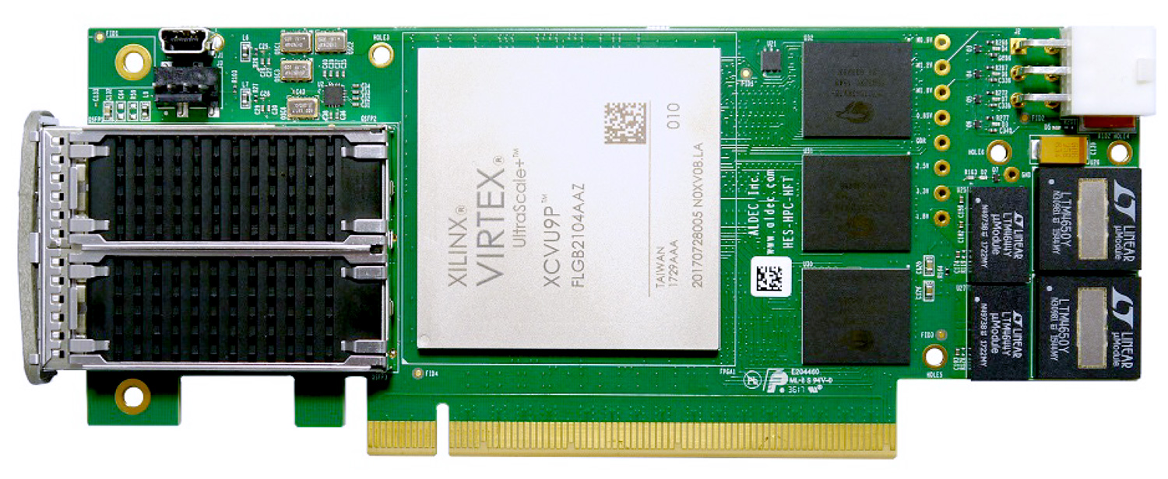
FPGAs
“It’s hardware that makes a machine fast. It’s software that makes a fast machine slow.”
Craig Bruce
Notes:
Transition

Slide 9
When the Software World’s Best Isn’t Good Enough
FPGAs – what are they?
Short for “field-programmable gate array”
They are chips designed to execute a specific trading algorithm
Their properties allow them to execute algorithms orders of magnitude faster than equivalent software implementations on general-purpose hardware
FPGAs are “programmed” through hardware
An FPGA chip is made of millions of logic blocks called lookup tables
Each logic block carries out logical operations such as and, or, nand, xor, etc
A set of configurable switches connects logic blocks together, forming an algorithm
Notes:
Christo

Slide 10
FPGAs – Parallelism
FPGAs are used for two main reasons:
Parallelism – FPGAs allow algorithm developers to get away from the OS, interrupts, context switching, CPU interfaces, and other extraneous factors when writing software for CPUs.
FPGA processing paths can be highly parallel, with many control loops running at once at different rates.
This parallelism means that FPGAs naturally lend themselves to simpler problems and problems that are processor-bound.
Notes:
Christo

Slide 11
FPGAs – Determinism
Another important upside of FPGAs is determinism
If you were here last time and remember, I was going over some compiled machine code, and I was asked “How long does each instruction take to execute?”
There’s no easy answer for that question, because CPUs are well known for randomness in processing.
The hardware will try all kinds of tricks to optimize instruction execution speed, but occasionally they fail and lead to unpredictable penalties
The OS imposes overhead that is far from constant
Event-driven interrupts (like when you type or move your mouse) give a near-infinite number of path variations through program flow
These qualities make CPUs the better form of hardware for complex problems that don’t require highly parallelizable hardware and change constantly in scope
Notes:
Christo

Slide 12
(cont’d)
This determinism leads to resilience – FPGAs can be depended on to output the same result from an input, no matter how saturated the network or any other part of the environment is
Lack of arbitrary jumps from interrupts limits the number of states the system can be in, which also adds to resilience and makes testing easier, along with making it easier to reason about the algorithms involved
FPGAs are safe from the typical problems of IT systems – software updates, config changes, downtime, etc
Notes:
Christo

Slide 13
Applications
Some tasks FPGAs could be used for:
Parsing incoming data, providing data filtering, decoding, and normalization
Carrying out pre-trade volume, price, and collateral checks
Monitoring the value and loss scenarios of financial portfolios on an ongoing basis
Calculating yields from fixed income investments, prices of securities and their derivatives
Generating outgoing orders, transmitting them to the matching engines
Some tasks FPGAs typically wouldn’t be used for:
Calculating the orders needed to rebalance a portfolio
Populating price and news sources into trading indicators
Notes:
Ray
https://www.reddit.com/user/modern_football/

Slide 14
Hybrid Architecture
Most firms use combinations of CPU cores and programmable logic gates
CPUs can stick to taking on complex tasks, FPGAs can make sure the simple stuff gets done in nanoseconds – or faster
Notes:
Ethan

Slide 15
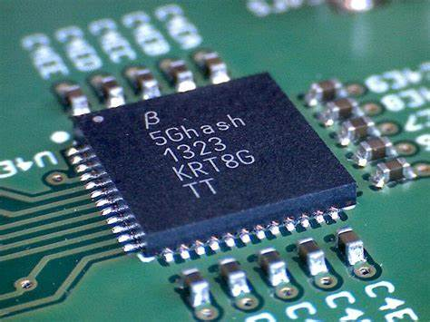
ASICs
“People who are really serious about software should make their own hardware.”
Alan Kay
Notes:
Transition

Slide 16
The Three Types of Hardware Circuits
CPUs, FPGAs, and ASICs are all types of hardware circuits, and you can think of them as sitting on a spectrum
CPUs are at the flexibility side of the performance spectrum. They offer highly generalized instructions that make them suitable for a wide variety of tasks and programmable through software (which is easiest!)
This means they’re comparatively slow, since they have to select from the available generic instructions to complete each task.
When going from running logic on CPUs to running it on FPGA, you gain some speed, since you aren’t held back by unnecessary hardware and the slowdowns of the CPU. They can carry out specific tasks quickly and effectively, and can even process several tasks in parallel. You still retain some programmability, but it’s harder (since it now consists of programming hardware configuration instead of software).
Notes:
Tom
https://www.davidhbailey.com/dhbpapers/overfit-tools-at.pdf

Slide 17

Notes:
Ray

Slide 18
The Application-Specific Integrated Circuit
ASICs (often referred to as “custom silicon”) are physical semiconductor devices that are programmed to perform one and only one task.
You can think of them as sitting on the opposite side of the spectrum from CPUs. 0 programmability or flexibility, but maximum speed, determinism, and resilience
They have the following upsides:
Low latency: ASIC's processing capability allows for extremely fast execution times, in the order of nanoseconds.
Deterministic performance: unlike software-based solutions, ASICs provide a deterministic environment, ensuring stable and predictable performance.
Customization: ASICs can be tailored to specific algorithms and strategies, offering a high level of performance and security.
Notes:
Ray

Slide 19
They’re all around us!
ASICs are used to mine bitcoin
GPUs are actually made up of many ASICs
Modem chips are sometimes ASICs
Flash memory controllers and Ethernet network interface controllers are ASICs
Notes:
Ethan

Slide 20
Types of ASICs
ASICs come in “full-custom” and “semi-custom” types
Full-custom design gives the designer more low-level control over what the ASIC looks and acts like. This is costlier and overall harder to pull off, but the rewards are massive performance gains and interoperability with other already designed components
Semi-custom design introduces some predefinition of devices (such as transistors) and leaves the job of design as defining the connections of devices and layers. You trade some low-level control and performance for reduced cost and time spent
Notes:
Christo

Slide 21
QUESTIONS AND ANSWERS
Contact us!
Email: quants@case.edu
Instagram: @cwruquants

